Slide 1

Smart Home Automation System
This presentation explores the development of a cost-effective, sensor-based smart home automation system that enhances security, convenience, and energy efficiency.
Parveen - 23MCI10053
Ashish Ved - 23MCI10057

Slide 2
Project Introduction
What is a Smart Home Automation System?
Why Smart Home Automation?
Traditional homes require manual control over devices, leading to energy wastage and security concerns.
A technology-driven system that automates household appliances and enhances security.

Slide 3

Clarity of Problem Definition
Manual Control of Devices
Energy Wastage
Lights and fans are often left ON unnecessarily.
Requires human effort to switch ON/OFF fans, lights, and doors.
Security Risks
Gas leaks can go undetected; unauthorized people can enter without alert.

Slide 4
Proposed Solution
System Overview
Components Used
A sensor-based home automation system using Arduino that detects gas leaks, opens doors automatically, controls fan operation, and manages light usage.
Arduino Board
Smoke Detector MQ6
Ultrasonic Sensor
PIR Sensor
LDR Sensor
Relay Board (2-channel)
DC Power Source (12V)

Slide 5
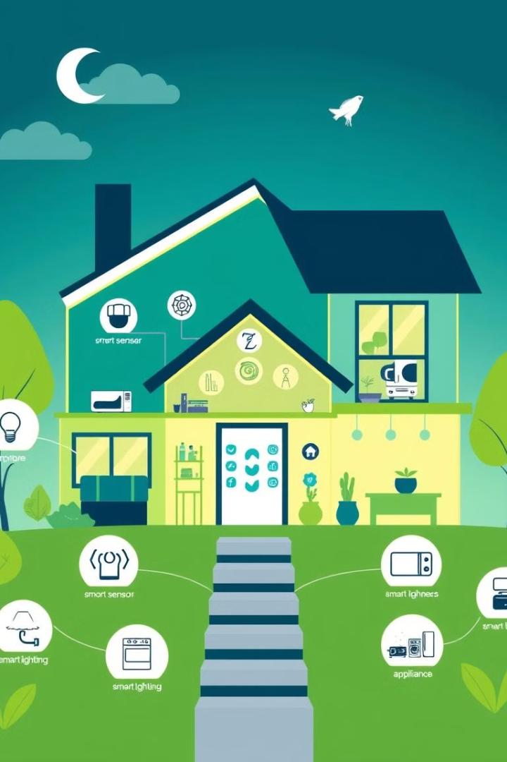
Literature Review
1
IoT-based Smart Home Systems
Expensive and require internet connectivity, posing security risks due to hacking threats.
2
Traditional Automation Systems
Rely on manual timers rather than real-time sensor-based automation, lacking adaptive intelligence for energy efficiency.

Slide 6
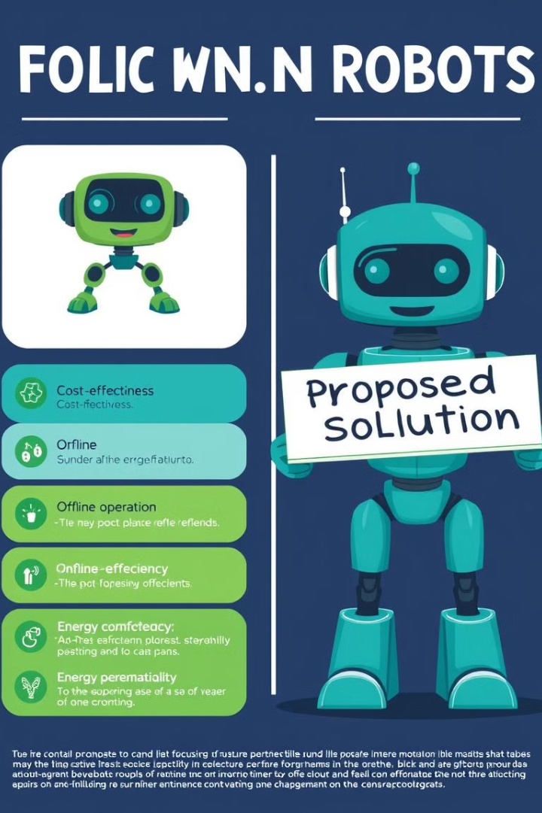




Innovativeness of Project Idea
Low-Cost Design
No Internet Dependency
Efficient Energy Management
Uses affordable sensors instead of high-end IoT modules.
Works completely offline, reducing security risks.
Lights and fans operate only when needed.
Enhanced Security Features
Gas leak detection and automated doors improve safety.

Slide 7

Alignment with Cluster Objective
Sustainability & Energy Efficiency
1
Reduces unnecessary power consumption by ensuring lights and fans are used only when required.
2
Safety & Security
Gas leak detection prevents accidents, automated doors enhance security, and motion-based control prevents misuse of electricity.
Technological Advancement
3
Uses microcontrollers and sensors for home automation, with future potential for AI and IoT integration.

Slide 8
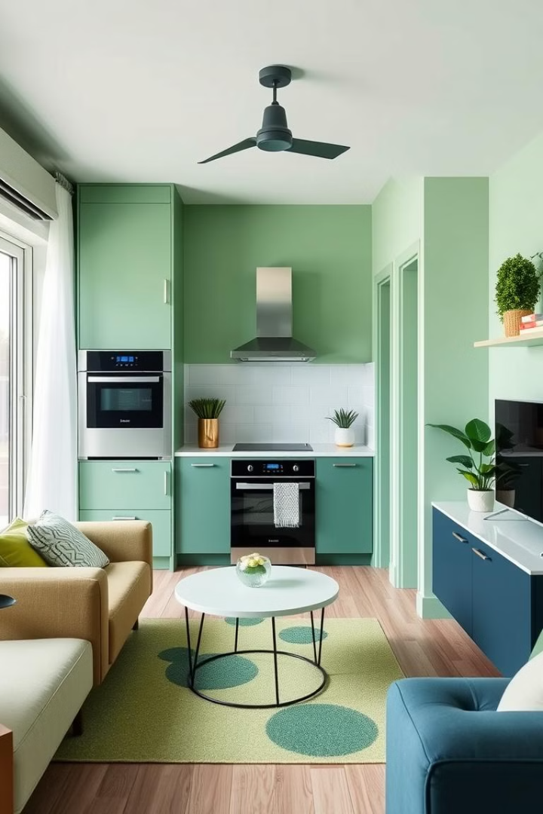


Conclusion
Key Takeaways
A Smart Home Automation System that is cost-effective, reliable, and energy-efficient.
Future Enhancements
Mobile App Integration, Voice Control Features, AI-Based Energy Optimization.

Slide 9

Thank You!
We appreciate your time and feedback! We welcome any questions you may have.

